Slide 1
TYPES OF CONFLICT
CONFLICT
A PROBLEM IN A STORY
BETWEEN THE PROTAGONIST AND ANTAGONIST
THAT NEEDS TO BE SOLVED BY THE RESOLUTION OF THE STORY.

Slide 2
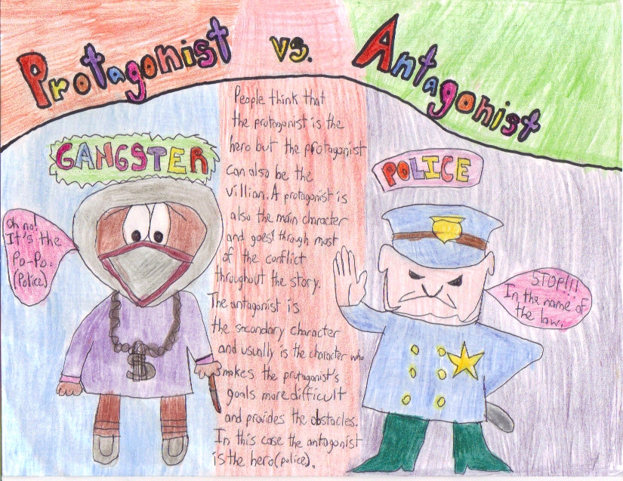
1. Person vs. person
A CONFLICT BETWEEN TWO
OR MORE CHARACTERS.
EX: A CONFLICT BETWEEN THE
PROTGAGONIST & ANTAGONIST

Slide 3
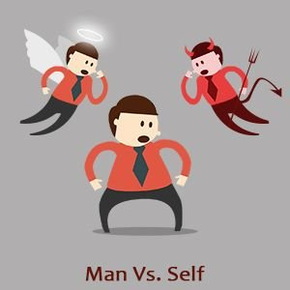
2. Person vs. self
A CONFLICT BETWEEN A CHARACTER
AND HIMSELF OR HERSELF.
EX: A CHARACTER HAS
AN INTERNAL CONFLICT OR STRUGGLE:
SHOULD I DO THE RIGHT THING OR NOT?

Slide 4
3. Person vs. nature
A CONFLICT BETWEEN A CHARACTER
AND THE NATURAL WORLD.
EX: A CHARACTER HAS
A CONFLICT WITH A PLANT, ANIMAL, OR WEATHER.

Slide 5
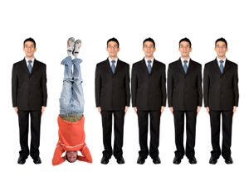
4. Person vs. society
A CONFLICT BETWEEN A CHARACTER
AND A GROUP OF PEOPLE.
EX: A CHARACTER GOES AGAINST
THE NORMS OF SOCIETY.
TOPICS MAY INCLUDE
RACISM, SEGREGATION, OR RELIGION.

Slide 6
5. Person vs. supernatural
A CONFLICT BETWEEN A CHARACTER
AND FANTASY OR OTHER-WORLDLY BEING.
EX: A CHARACTER GOES AGAINST
GHOSTS, WITCHES, OR ALIENS.

Slide 7
6. Person vs. technology
A CONFLICT BETWEEN A CHARACTER
AND A MACHINE.
EX: A CHARACTER HAS A PROBLEM
WITH A COMPUTER OR CELL PHONE.

