Slide 1
Prepare for the 2018-19 PSAT™ 8/9
Contents
What Is the PSAT 8/9?
Benefits of the PSAT 8/9
When Is the PSAT 8/9?
Skills Tested on the PSAT 8/9
How to Prepare for the PSAT 8/9
Resources

Slide 2
Some Key Facts
The PSAT™ 8/9 is designed for 8th‐ and 9th‐grade students.
The PSAT 8/9 is a test that will help educators and students figure out what students need to work on most so that they are ready for college when they graduate from high school.
Scores for the SAT® Suite of Assessments (SAT, PSAT/NMSQT®, PSAT™ 10, and PSAT 8/9) are reported on a common vertical scale, allowing educators and students to measure progress.
Test length: 2 hours and 25 minutes.
There’s no penalty for guessing or blank responses, also known as “rights-only scoring.”
PSAT-related assessments provide the same scores on different scales (see slides 13 and 14) with two exceptions:
Only the SAT offers the Essay scores
PSAT 8/9 does not provide a score in Passport to Advanced Math

Slide 3
Benefits of the PSAT 8/9
The PSAT 8/9 establishes a baseline measurement of college and career readiness.
The PSAT 8/9 tests the same skills and knowledge as the SAT, PSAT/NMSQT, and PSAT 10—in a way that makes sense for each grade level.
Personalized practice on Khan Academy® gives students age 13 and over the opportunity to upload their test results to receive targeted learning plans that students can use to learn more about and practice the skills they need to improve.
The score reports will give students comprehensive, personalized feedback on test performance, allowing students to see which questions were answered incorrectly (with exceptions) and which academic skills they should work to improve.
Information on college majors and career exploration is offered by the College Board and Roadtrip Nation.

Slide 4
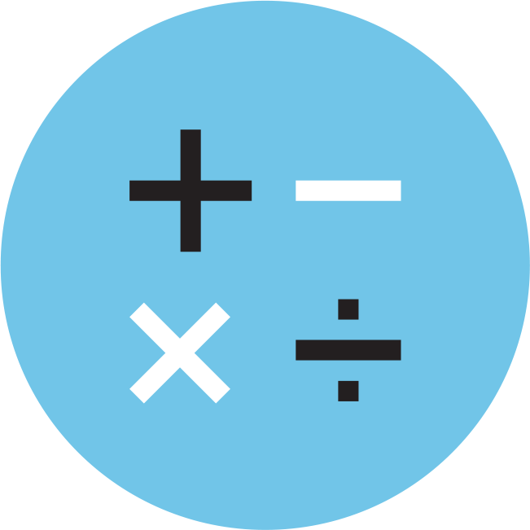
Skills Tested
Reading Test
Writing and Language Test
Math Test
Each test assesses the academic skills that students developed over the years, primarily through coursework.
These skills are considered essential for success in high school, college, and career.

Slide 5
Reading Test
42 passage‐based questions; 55 minutes
4 single passages and 1 pair of passages
Quick Facts
All questions are multiple choice and based on passages.
Some passages are paired with other passages or informational graphics such as charts, graphs, and tables.
No mathematical computation is required.
Prior topic-specific knowledge is never tested.

Slide 6
Reading Test
What to Expect
The Reading Test always includes:
One passage from a classic or contemporary work of U.S. or world literature
One passage or a pair of passages from either a U.S. founding document or a text in the great global conversation they inspired. The U.S. Constitution or a speech by Nelson Mandela, for example
A selection about economics, psychology, sociology, or some other social science
Two science passages (or one passage and one passage pair) that examine foundational concepts and developments in Earth science, biology, chemistry, or physics

Slide 7
Writing and Language Test
40 passage‐based questions; 30 minutes
4 passages
Quick Facts
All questions are multiple choice and based on passages.
Some passages are paired with informational graphics such as charts, graphs, and tables.
No mathematical computation is required.
Prior topic-specific knowledge is never tested.
The Writing and Language Test is part of the Evidence-Based Reading and Writing section.

Slide 8
Writing and Language Test
What to Expect
The Writing and Language Test puts students in the active role of an editor who is improving a written passage. Most questions ask students to decide which, if any, of the three alternatives to an underlined part of a passage most improves it.

Slide 9
Math Test
2 test sections; 60 minutes
38 questions (31 multiple choice, 7 grid-ins)
Quick Facts
Most math questions will be multiple choice, but some will be student-produced responses (grid-ins).
The Math Test is divided into two portions: Math Test – Calculator and Math Test – No Calculator.
Some parts of the test will present a scenario and then ask several questions about it.

Slide 10
Math Test
What to Expect
The Math Test focuses on the math that matters most for college and career readiness. To succeed on the Math Test, students will need to demonstrate mathematical practices, such as problem solving and using appropriate tools strategically.
Heart of Algebra
Problem solving and data analysis

Slide 11
Math Section
Students: Know Your Calculator
A scientific or graphing calculator is recommended.
Students should bring a familiar calculator. Test day is not the time to figure out how to use a new calculator.
Math Test – Calculator

Slide 12
Math Section
Additional Calculator Tips for Students
Don’t try to use the calculator on every question—no question requires one.
Decide how to solve each problem; then decide whether to use a calculator.
Make sure your calculator is in good working order and that batteries are fresh.
Students will not be permitted to use laptops or other computers, tablets, cell phones, or smartphones, etc. Please reference the student guide for a complete list.
Math Test – Calculator

Slide 13
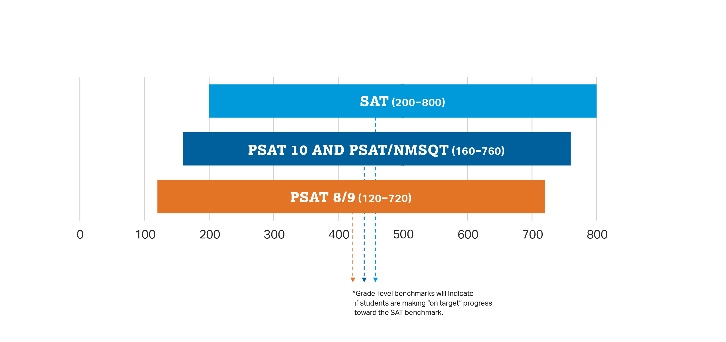
How Does the PSAT 8/9 Connect to the PSAT 10, the PSAT/NMSQT, and the SAT?
Content and Domain Alignment
All tests in the SAT Suite of Assessments (SAT, PSAT/NMSQT, PSAT 10, and PSAT 8/9) are aligned to the same research backbone and focus on the same domain of knowledge and skills.
Scoring
All tests in the SAT Suite of Assessments are on a common score scale that provides consistent feedback, enabling students to tailor their practices to the areas where the most help is needed to help them move forward.

Slide 14
Longitudinal Progress Monitoring
Section Scores are placed on a vertical scale.
SAT (200–800)
PSAT 10 & PSAT/NMSQT (160–760)
PSAT 8/9 (120–720)
100 200 300 400 500 600 700 800
The same concept holds true for the Test, Cross-Test Scores, and Total Score.
SAT (10–40)
SAT (400–1600)
PSAT 10 & PSAT/NMSQT (8–38)
PSAT 10 & PSAT/NMSQT
(320–1520)
PSAT 8/9 (6–36)
PSAT 8/9 (240–1440)
14
6 10 15 20 25 30 35 40
200 400 600 800 1000 1200 1400 1600

Slide 15
SAT College and Career Readiness Benchmarks
Total scores, section scores, test scores, and cross-test scores are vertically scaled.
Improved scores demonstrate growth from assessment to assessment.
Subscores aren’t vertically scaled.
Subscores provide information, allowing students to pinpoint areas for improvement.
Improved scores don’t demonstrate growth from assessment to assessment at the subscore level.
 | Grade 8 | Grade 9 | Grade 10 | Grade 11 | SAT
Section Level | 390 | 410 | 430 | 460 | 480 | ERW
 | 430 | 450 | 480 | 510 | 530 | MATH

Slide 16
How to Prepare for the PSAT 8/9

Slide 17
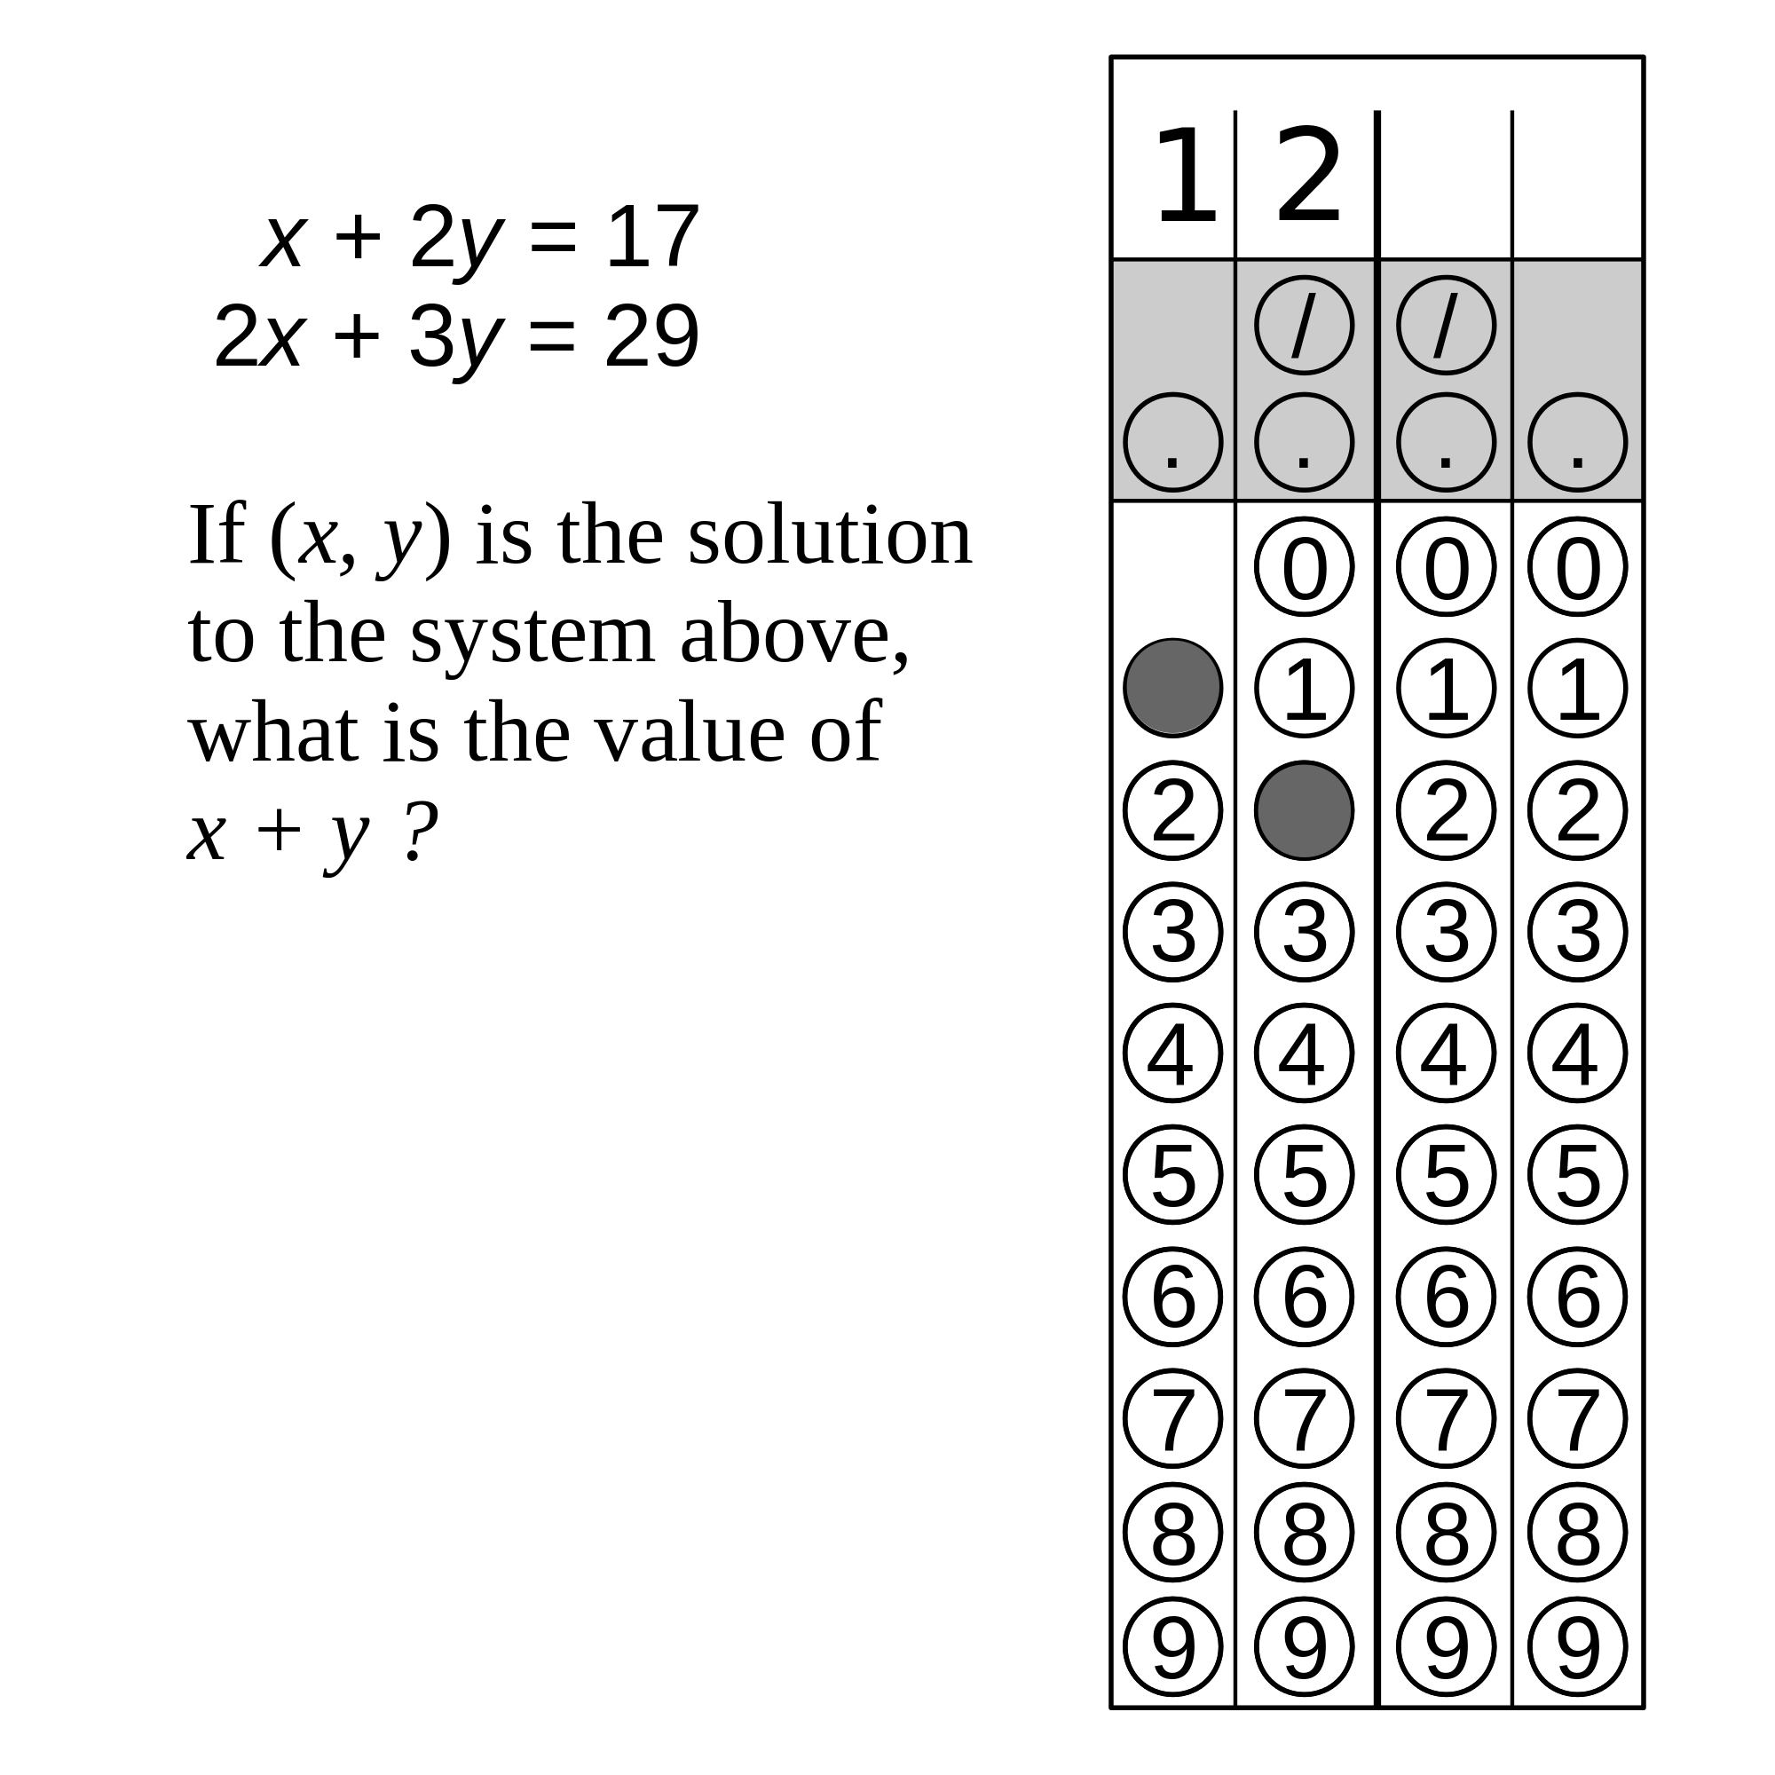
Know How the PSAT 8/9 Is Scored
Rights-Only Scoring
1 point for each correct answer
0 points deducted for each incorrect or blank question
Math Grid-ins
Enter answers as (reduced) fractions or decimals.
If rounding a decimal, make sure to use every box.
Scale
120–720 for each test section
240–1440 for the total score

Slide 18
Personalized Skills Information
The PSAT 8/9 Score Report
Contains information to help students improve their academic skills.
Lists skills that students have the best chance of improving with additional work.
Connects students to personalized practice recommendations on Khan Academy.

Slide 19
Resources

Slide 20
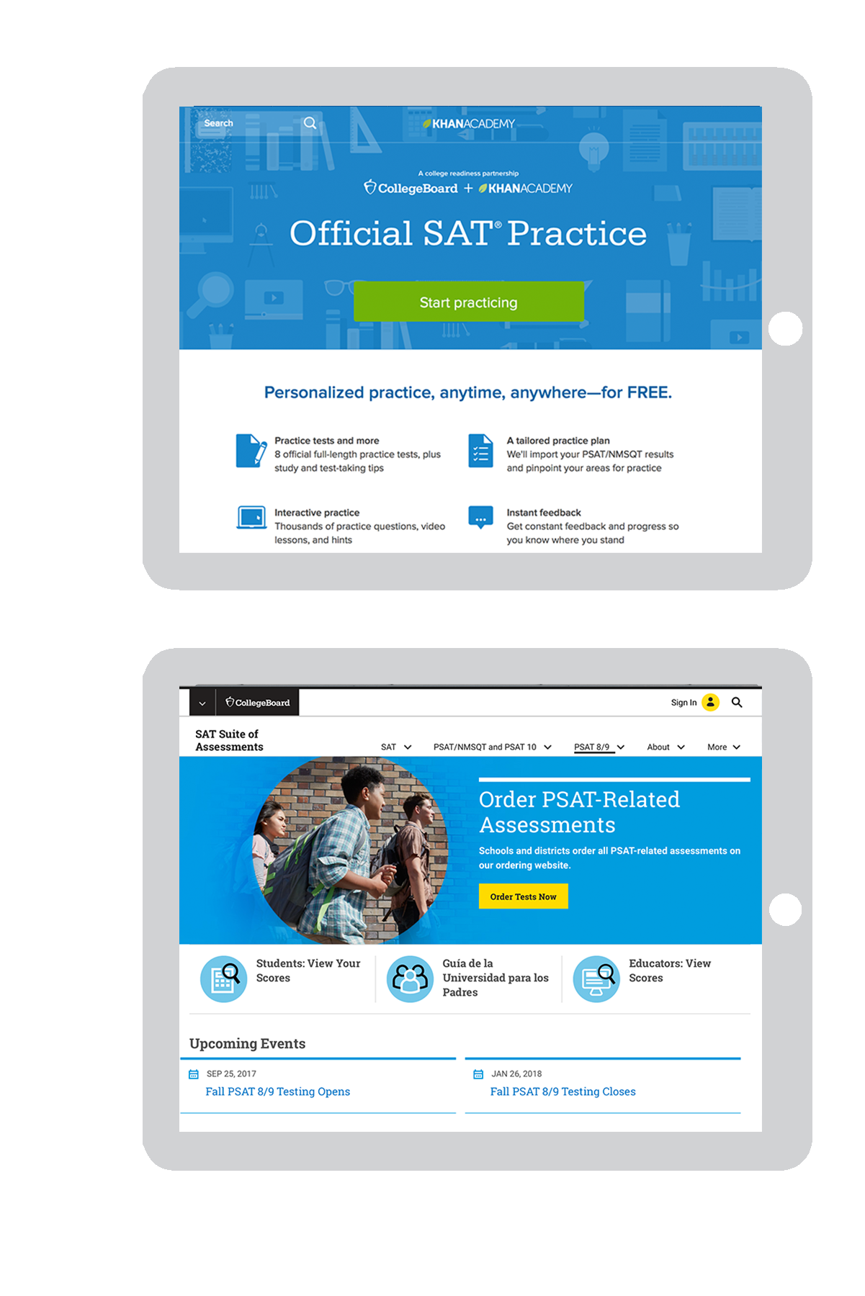
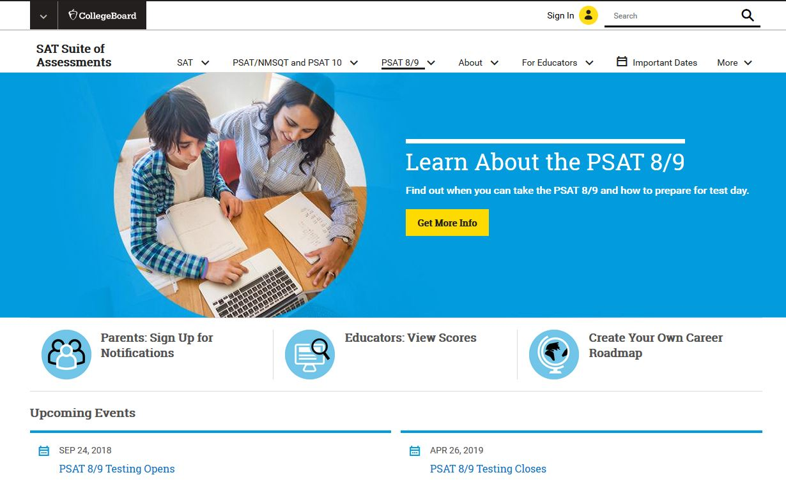
Resources
For personalized resources aligned to the SAT Suite of Assessments (including PSAT 8/9, PSAT 10, and PSAT/NMSQT), please visit:
satpractice.org
For general information about the PSAT 8/9, please visit:
psat.org/8-9

Slide 21
Thank you for your time are there any questions?

