Slide 1
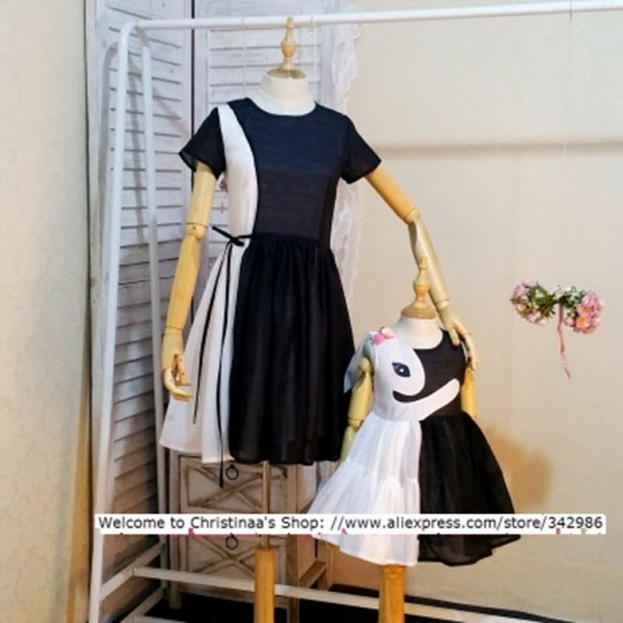
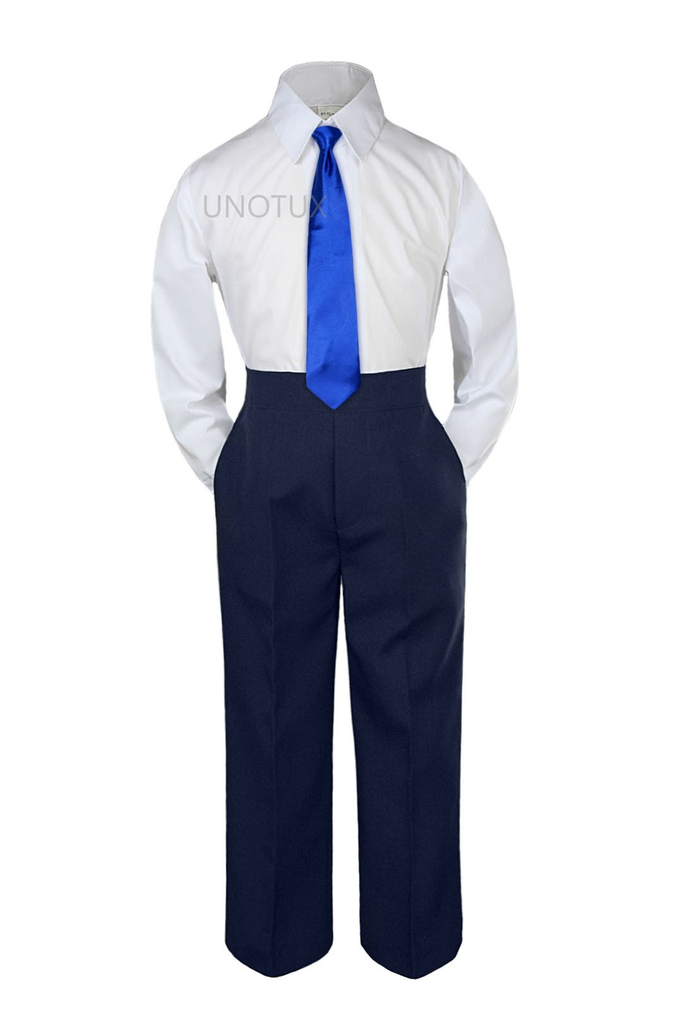
CMIT 5TH GRADE PROMOTION
DATE: 06 JUNE 2019
TIME: 6-7:30 P.M.
LOCATION: CMIT SOUTH MIDDLE/HIGH SCHOOL
ATTIRE: NAVY BLUE AND WHITE

Slide 2
CMIT 5TH GRADE PROMOTION
You are cordially invited to the promotion of Thee CMIT South Elementary School

