Slide 1

Financial Aid

Slide 2
Agenda
What is financial aid
Eligibility requirements
Application process
Types of financial aid
Satisfactory academic progress (SAP)

Slide 3
FERPA
The Family Educational Rights and Privacy Act (1974)
The Family Educational Rights and Privacy Act (FERPA) (20 U.S.C. § 1232g; 34 CFR Part 99) is a Federal law that protects the privacy of student education records. The law applies to all schools that receive funds under an applicable program of the U.S. Department of Education.
FERPA gives parents certain rights with respect to their children's education records. These rights transfer to the student when he or she reaches the age of 18 or attends a school beyond the high school level. Students to whom the rights have transferred are "eligible students."
Are there some specific things that parents and their student should discuss?

Slide 4
Financial Aid
  GRANTS
  SCHOLARSHIPS
  FEDERAL WORK STUDY
  FEDERAL LOANS
  HOW CAN I PAY FOR COLLEGE?

Slide 5
Eligibility Requirements
A U.S. citizen or eligible non-citizen
Must have a high school diploma or GED
Not in default on a federal student loan
Enrolled in an eligible degree program
Enrolled in at least 6 credits (for student loans)

Slide 6
HOW DO I APPLY FOR FINANCIAL ASSISTANCE?
Apply online – beginning October 1st
www.fafsa.gov
Download myStudentAid mobile app
Create FSA ID and Password
www.studentaid.gov/fsaid
Include Federal School Code
002089

Slide 7
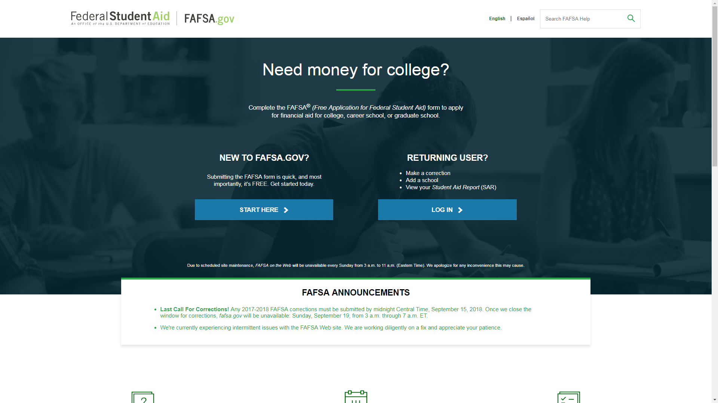
Free Application for Federal Student Aid - FAFSA

Slide 8
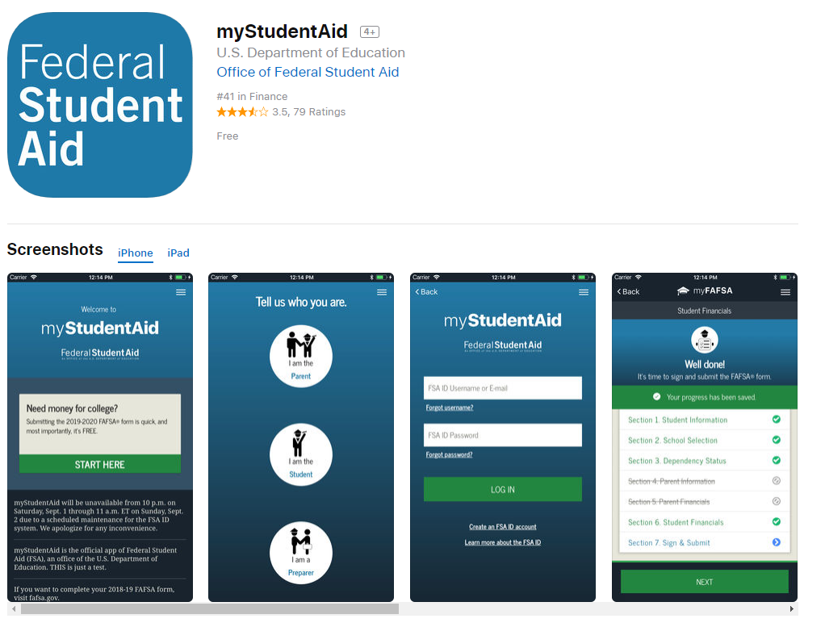

Slide 9
TYPES OF AID
Grants
Federal Pell Grant
Federal Supplemental Educational Opportunity Grants (FSEOG)
Maryland State Grants
Federal Aid and Direct Student Loans
Student Loans
Work Study
Scholarships
State
Institutional
Private

Slide 10
FEDERAL PELL GRANT
Available to undergraduate students who have not earned their first Bachelor’s degree
Amount awarded is based upon the student’s EFC and enrollment level
Students may not receive more than 12 full-time semesters of the Federal Pell Grant

Slide 11
FEDERAL SUPPLEMENTAL EDUCATIONAL OPPORTUNITY GRANT(FSEOG)
FSEOG is for Undergraduate students with exceptional financial need
The program gives priority to students who receive the Federal Pell Grant
Award amounts are at the discretion of the college or university

Slide 12
INSTITUTIONAL SCHOLARSHIPS
Institutional aid offered from college resources
Aid may include grants or scholarships
Application processes may vary
Awarded based on need and/or merit and can vary in amounts and availability by college

Slide 13
STATE SCHOLARSHIPS
Aid awarded by the state to students seeking a degree generally at a school within the state
Aid may include but is not limited to scholarships, grants, and low-interest loans
Students may need to submit additional applications other than FAFSA to be considered for aid
State aid can be either need or merit-based
Administered by the state’s education agency
FAFSA Deadline - March 1, to be considered for Maryland State scholarships and grants
Maryland Community College Promise scholarship – beginning 2020
www.mhec.state.md.gov

Slide 14
STUDENT LOANS
Federal Direct Loans
Loan funds are received directly from the federal government which must be repaid by the student after the 6 month grace period expires
Students must enroll half-time (6 credit hours) to qualify
Lifetime Aggregate Limits:
  $31,000 for a dependent undergraduate
  $57,500 for an independent undergraduate

Slide 15
DIRECT SUBSIDIZED LOAN
Available only to undergraduate students based on financial need
Federal government pays the interest while the loan is in deferment
No student may receive more than $23,000 in Subsidized Direct Loans

Slide 16
DIRECT UNSUBSIDIZED LOAN
Available to undergraduate and graduate students regardless of financial need
Students are responsible for the interest over the life of the loan, including while they are in school
Interest rates are fixed at 4.53%
Students may receive up to the lifetime aggregate limits less Subsidized loan amounts

Slide 17
FEDERAL WORK STUDY
Program that provides on-campus (and select off-campus) employment to eligible students
ED provides the funds to the College. Each institution has its own restrictions on the way it allocates funds.
Students are paid bi-weekly (this too can vary by institution, but students must be paid at least once a month)
Income earned through FWS is taxable and reported to the IRS; the income is not counted against the student when completing a FAFSA

Slide 18
Satisfactory Academic Progress
Federal regulations require that a student meet basic academic progress standards before he or she can receive federal financial aid.
Complete 67% of credits attempted
Graduate on time
Maintain cumulative GPA of 2.0
The satisfactory academic progress policy can be found online.

Slide 19
Important Things to
Remember
Apply for aid as soon as possible after October 1st of every year
Priority deadline for Maryland residents to submit FAFSA - March 1st
PGCC Institutional Scholarship deadline - April 15th

Slide 20

Let us assist you…
We are located in Bladen Hall Room 121
Hours: Monday – Thursday
8:30 AM to 8:00 PM
Friday
12:00 PM to 5:00 PM
Office: 301.546.0822
Email your questions to Finaid@pgcc.edu

