Slide 1
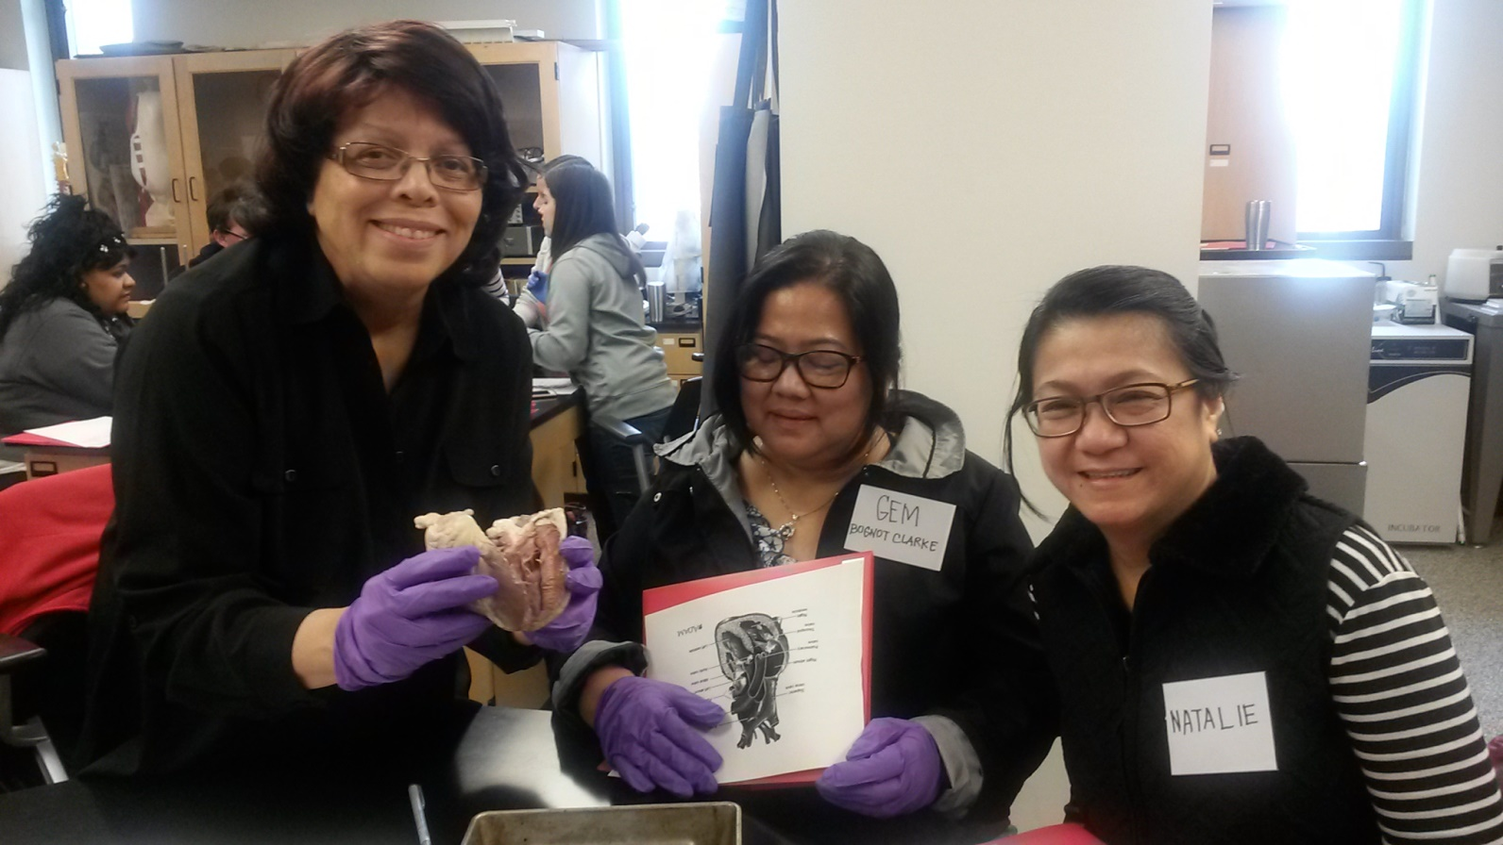
CMIT-North High School Science Faculty Selected to Attend Naval Academy STEM Training The CMIT-North science educators shown in the above picture in the Naval Academy’s anatomy lab are: L. to R.: Ms. Alma Smith, Dr. Gemma Clarke, and Ms. Natalie Crespo

