Slide 1
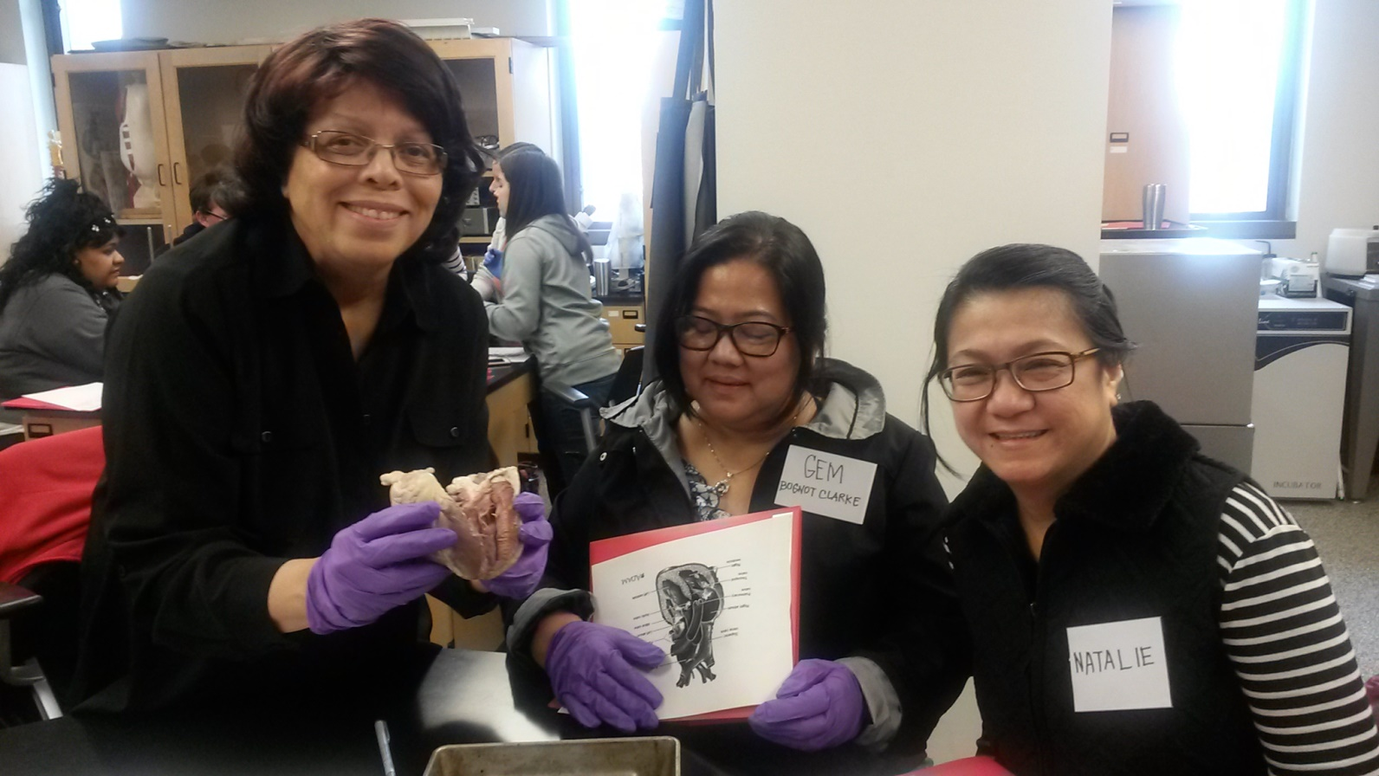
CMIT-North High School Science Faculty Selected to Attend Naval Academy STEM Training
Congratulations to the CMIT-North Science Faculty selected to participate in the 2016-STEM Educator Training held on the campus of the United States Naval Academy located in Annapolis, Maryland.
The CMIT-North science educators shown in the above picture in the Naval Academy’s anatomy lab are:
L. to R.: Ms. Alma Smith, Dr. Gemma Clarke, and Ms. Natalie Crespo. The all-day engineering/anatomy program focused on project-based learning in STEM, with topic areas including Engineering Design, Applied Math, Computers/Cyber Unplugged, Biology/Bioengineering, Physics of Sound, Technology/Intro to Arduino, and Energy Transformations.
Special acknowledgements to U.S. Naval Academy Faculty : Dr. Angela Moran, PhD, Mechanical Engineering Professor and Dr. Sarah Durkin, Ph.D., Professor of the Practice, at the STEM Center for Education and Outreach

