Slide 1

“International travel helped open my eyes and become more in tune with the world around me.”
-Student Traveler

Slide 2

“I was able to
explore new horizons and see the world from a different perspective. This adventure was one of the best I have experienced.”
-Student Traveler

Slide 3

“I will never forget
how wonderful I felt when our plane landed. I learned so much about myself and for that I am grateful.”
-Student Traveler

Slide 4
“Students stepped out of their comfort zones. Friendships were strengthened as they experienced this event together.”
-Teacher

Slide 5

“Coming home, I feel
more confident in my independence. I feel cultured and ultimately, I feel thankful for the friendships that I made on tour.”
-Student Traveler

Slide 6

“There aren’t enough adjective to describe this experience! It was utterly amazing.
Incredible food, sites & experiences. Everyone must go!
-Teacher

Slide 7
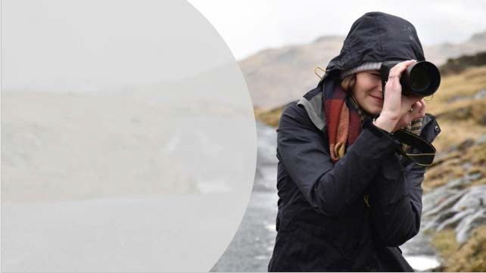
“This tour helped my
students immensely. Coming from a small, rural town, everything from the daily routines to the general atmosphere was mind- opening for the kids.”
-Teacher

Slide 8

“Introverts blossomed.
Extroverts led and made sure everyone was included in the fun.”
-Teacher

Slide 9

Housekeeping
A few action items
Please silence your phones Write questions on the exit ticket Return the ticket at the end About 30 minute meeting Enrollment to follow

Slide 10

Our Agenda
So what are we going to cover?
My travel story
Where and when
III.
Our partnership with EF
Tour itinerary
What’s included (and what’s not)
Price and how to enroll

Slide 11

My name is
Ms. Patricia Cameron
Years at School
Courses group leader teaches
First travel experience

Slide 12
Our amazing chaperones
Carolyn Thiebaud
Loretta Vincent

Slide 13

Let’s Watch!
https://www.youtube.com/watch?v=qewAzRUMDdY&t=6s

Slide 14
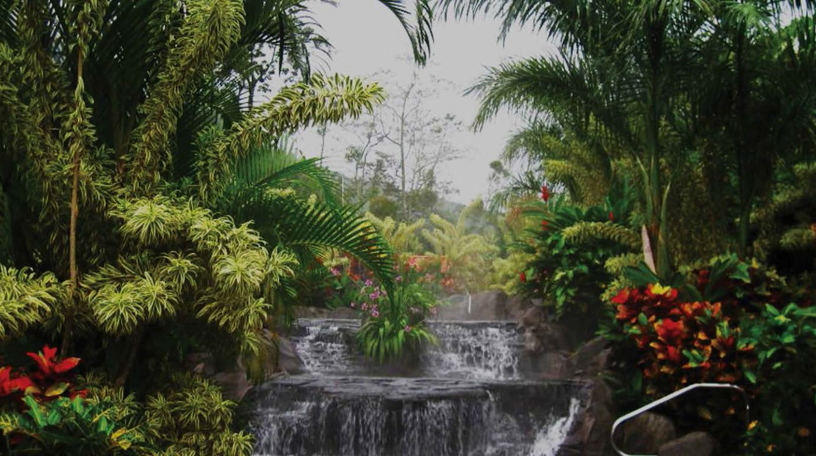
Let’s go to…
COSTA RICA
✈
A 9-day tour | Costa Rica’s Natural Wonders

Slide 15

Mark your calendars
We’ll be traveling sometime between…
Earliest departure
Latest return
8 DAY TOUR
Friday,
August 7, 2020
Saturday, August 22, 2020
*We’ll confirm exact departure and return dates closer to tour.

Slide 16

Group Travel
Meet students from around the country
Keeps our tour affordable
Allows more students to see the world
Make lasting friendships
Tour and departure flexibility match us with other groups

Slide 17

EF Educational Tours
Our travel partner
World leader in international education
50+ years of experience
500 schools & offices in 53 countries– including Costa Rica
Guaranteed lowest price

Slide 18

Let’s talk safety
We’ve got you covered!
EF provides our group with
24/7 Tour Director
Local presence
24-hour emergency line
Peace of Mind Policy
Support for my safety policies

Slide 19

Who else travels with EF?
CMIT North Laurel HS
Benjamin Banneker MS

Slide 20



Educational Resources
Preparing for life after high school
HIGH SCHOOL CREDIT
Earn credit with a personal project
COLLEGE CREDIT
Do college- level work and earn 3 credits
COLLEGE APPLICATIONS
Use your tour to inspire your personal essay

Slide 21

“We initially agreed to do this as a way of ‘beefing up’ his college resume. What we didn’t expect was the positive
change that he experienced.
Opening his eyes to the arts, cultures, and the world made for an extremely maturing experience.”
-Parent
Tullahoma, TN

Slide 22

Let’s Watch!
https://www.youtube.com/watch?v=VSET0UiqAsY
Notes:
Presenter
2018-11-02 17:47:07
--------------------------------------------
Direction: If you have troubles with the video, copy & paste the following: https://www.youtube.com/watch?v=VSET0UiqAsY

Slide 23
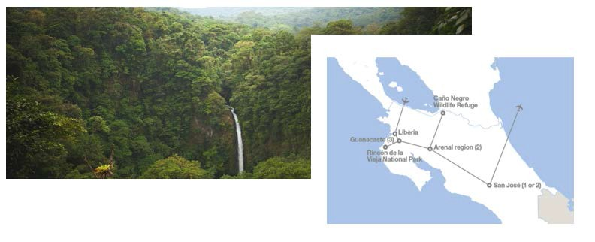
Our Itinerary
What we’ll see, do, eat, and experience
What are you excited about?

Slide 24
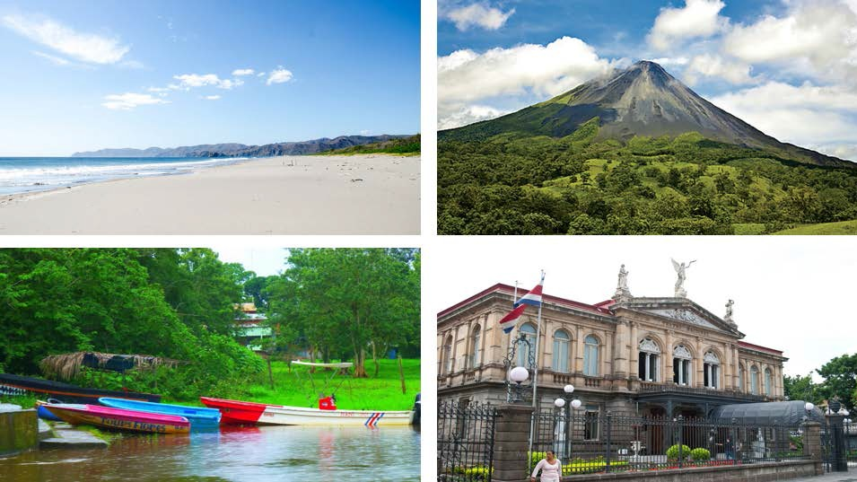
Guanacaste
Arenal
Los Chiles
San Jose

Slide 25
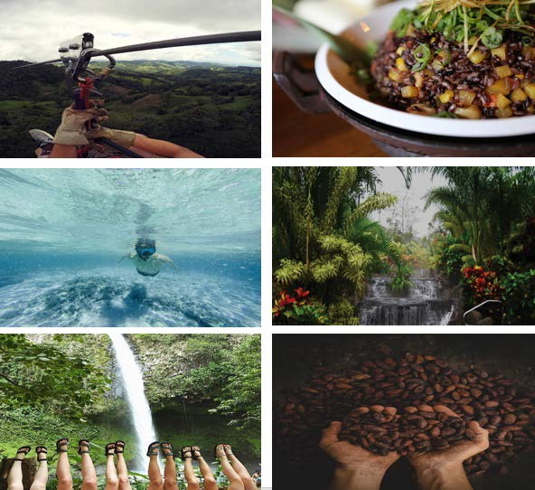
HIGHLIGHTS
Canopy Adventure
Cooking class
Snorkeling
Thermal Springs
La Fortuna Waterfall
Coffee Plantation

Slide 26





What’s Included
Round-trip airfare
Safe, quality hotel rooms 24/7 bilingual Tour Director
On-tour transportation Educational itinerary Guided tours and activities
Breakfast, lunch and dinner daily 24/7 on-tour assistance
Traveler Support Team Tour Donation Page
weShare online education platform UnCommon App college essay toolkit Travel backpack
Global Travel Protection Plan
(And a few things you'll need to cover)
Passport and visa fees Airport baggage fees Snacks
Spending money Tips

Slide 27
Price Details
Program Price
Global Travel Protection
EF’s Peace of Mind Program
Total current Program Price
Early Enrollment
Total for Students (under 20)
$ 2,575
$ 165
Free
$2,740
($200)
$ 2,540
New student travelers who enroll between February 25th – March 5th will receive a $200 savings ($2,540). New student travelers enrolling with a buddy by March 15th will receive will receive a $100 savings ($2,440).

Slide 28



Making it happen
We’ve got options
$72
BI-WEEKLY
$144
MONTHLY
$2540
IN FULL
DONATION PAGE

Slide 29
Price Details
w/Adult Supplement
$ 2,525
Program Price
Adult Supplement
$ 450
$ 165
Free
$3,190
($200)
Global Travel Protection
EF’s Peace of Mind Program
Total current Program Price
Early Enrollment
Total for Travelers 20 and older
$ 2,990
New Adult travelers who enroll between February 25th – March 5th will receive a $200 cost savings.

Slide 30
Making it happen
We’ve got options
$86
BI-WEEKLY
$171
MONTHLY
$2,990
IN FULL
DONATION PAGE

Slide 31

Who’s in?
LIMITED SPOTS AVAILABLE
ENROLL AT
eftours.com/2147267KB
EARLY ENROLLMENT $200 DISCOUNT ENDS
March 8, 2019

